Slide 1
Computer Graphics
UWP - Application Setup
Fernando Geraci

Slide 2
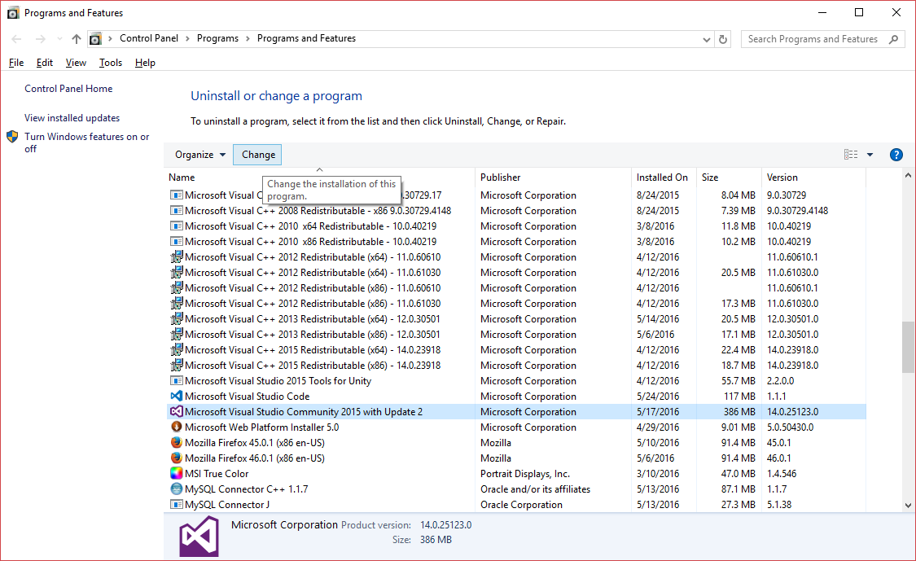
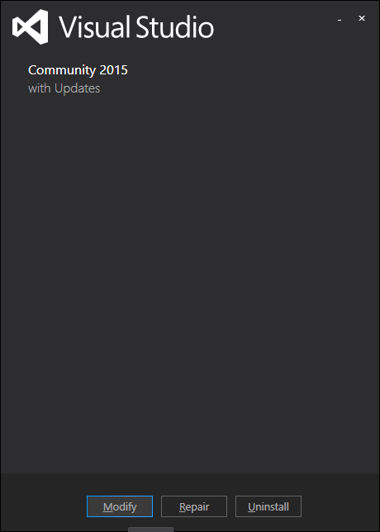
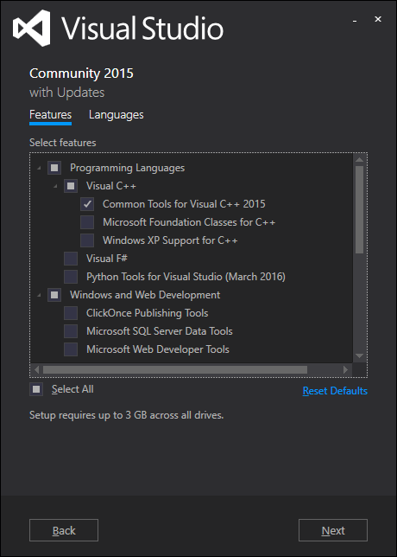
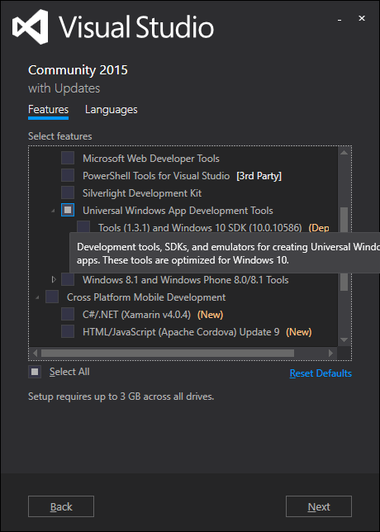
Requirements
Fernando Geraci
Visual Studio Community 2015 with latest Update (free)
Includes Direct3D SDK and utilities already
> Once installed, go to Programs and Features
> Select Microsoft Visual Studio Community 2015 …
> Click on Change
> Select Visual C++ and Universal Windows App Development Tools
> Install !

Slide 3
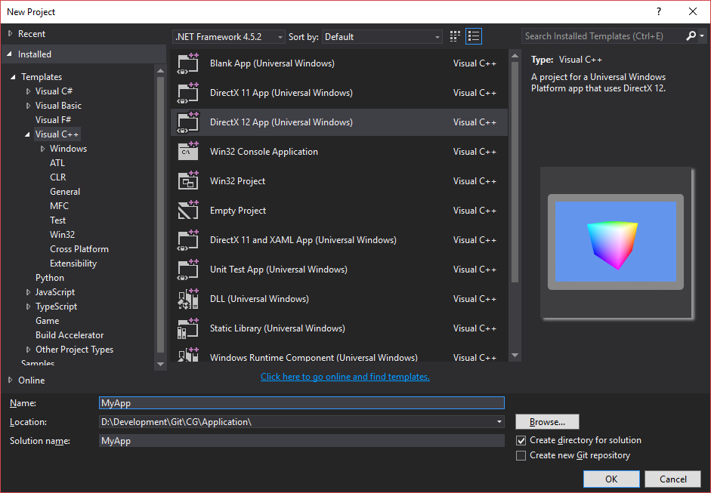
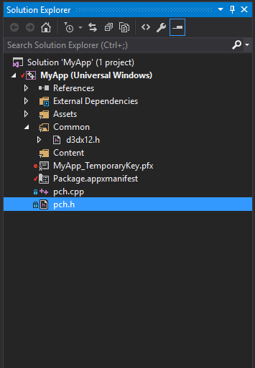
Application - Creating the Project
Fernando Geraci
Open VS2015 and create a new DirectX 12 Universal Windows App.
If you create the project in a folder where you already initialized a git repository, VS will set it up for you in the IDE later on. This is great for managing the project moving forward.
In the Solution Explorer, delete EVERYTHING but the files within ExternalDependencies, Assets and the ones displayed in the picture.
pch.h are pre-compiled headers. There, you can do project wide includes, note that D3D libs are already in place.
Recall that d3dx12.h is an utilities header file provided by D3D12, don’t get rid of this.

Slide 4
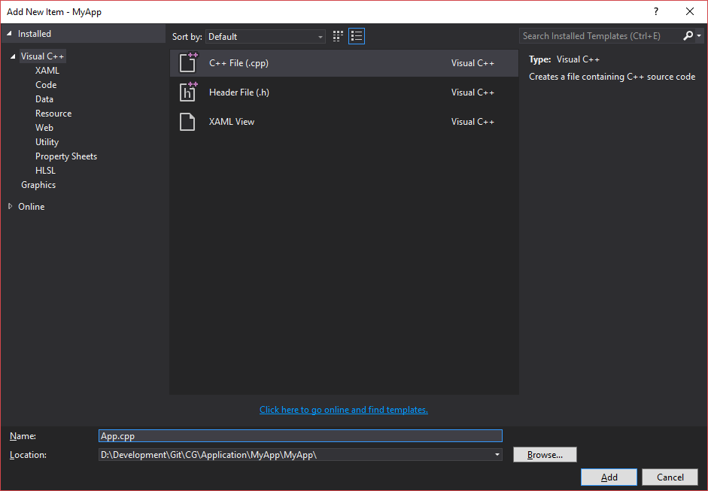
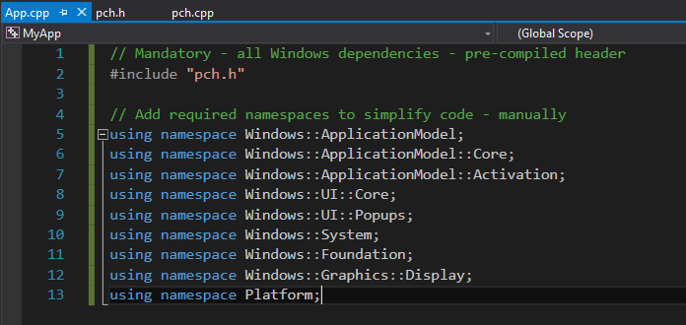
Application - Creating the Project
Fernando Geraci
Add a single .cpp file names App.cpp - here we will code everything required for a UWP application to work.
Once created, declare many of the namespaces we will use in the next steps.

Slide 5
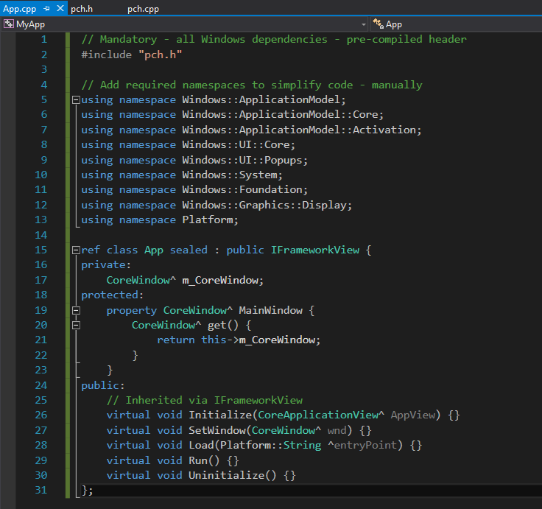
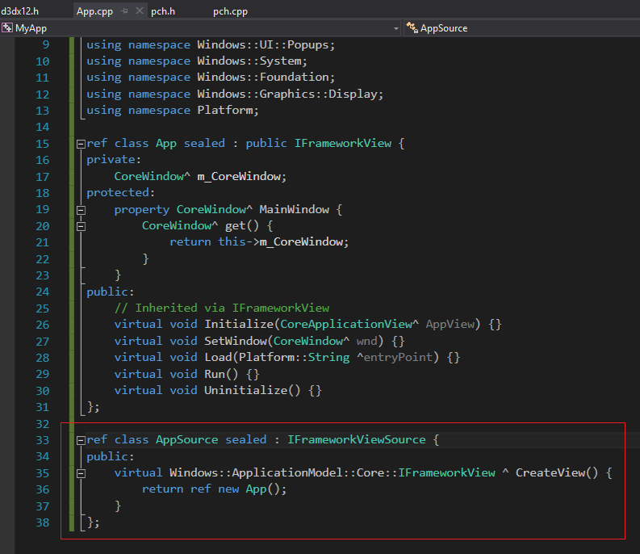
Application - App Setup
Fernando Geraci
The main application is an instance of an IFrameworkView class. This will have many abstract “life-cycle” and call backs methods which need to be implemented. We will complete these as we go. For now, just declare them as shown in the picture.
Secondly, add below the App class yet another one which implements the IFrameworkViewSource interface. This only needs the public CreateView function.

Slide 6
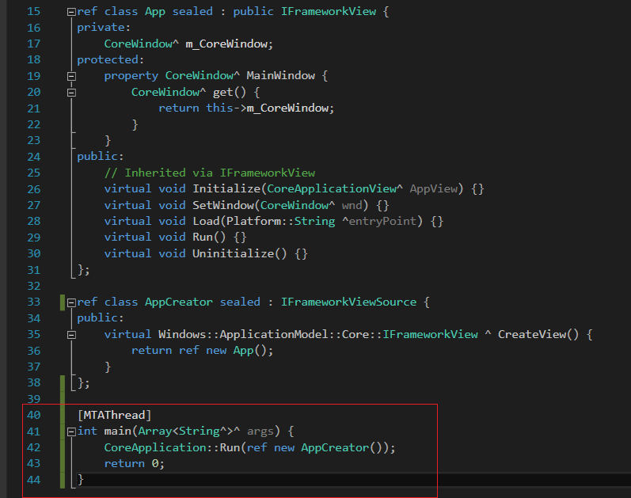
Application - App Setup
Fernando Geraci
Finally, implement the main function.
Note we are marking the main function as a Multi Threaded Apartment application.
Good, at this point, you should be able to build and run the application.
This will result in a quick splash screen which closes automatically with a message:
MyApp.exe has exited … code 0.
All good! Now we will start making it functional.

Slide 7
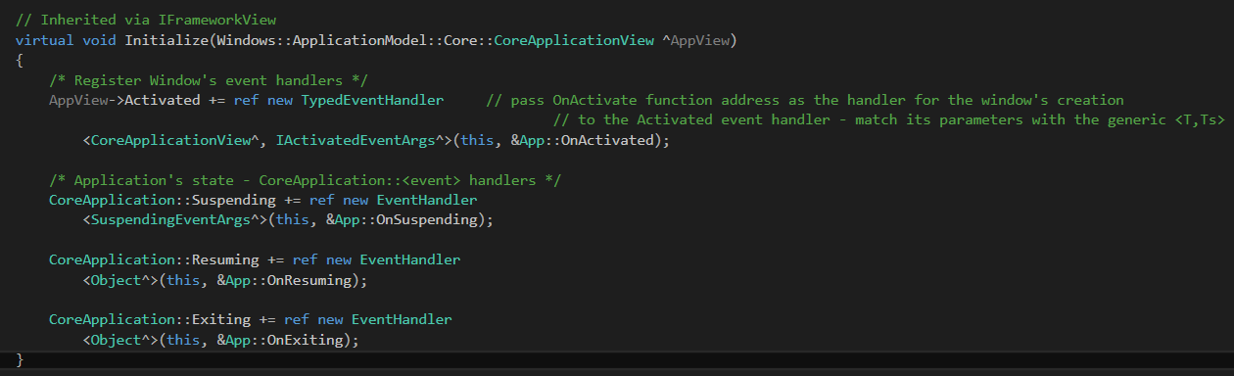
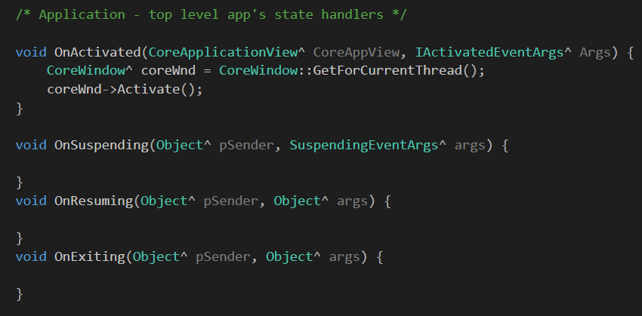
Application - App Setup
Fernando Geraci
1. Initialize()
Register application’s life-cycle event handler.
2. Implement the handlers for the life-cycle events.

Slide 8
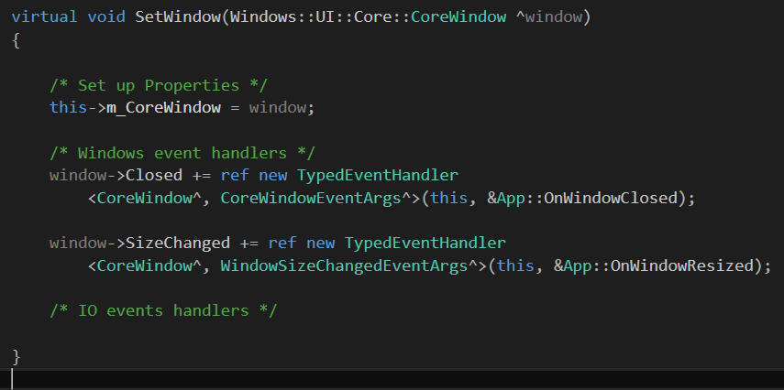
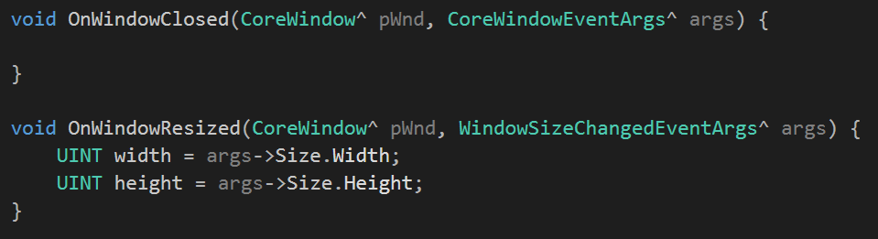
Application - App Setup
Fernando Geraci
3. SetWindow()
Register window’s event handlers.
4. Implement the handlers for the window

Slide 9
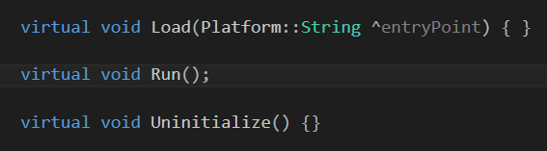
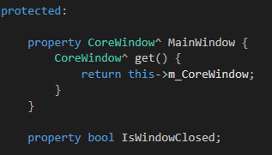
Application - App Setup
Fernando Geraci
5. Load, Run and Uninitialize
For now, Load and Uninitialize will be empty
We will define Run here but implemented outside the class definition.
6. Add a window control property
We will use this to set flags on whether the app’s main window has been closed.

Slide 10
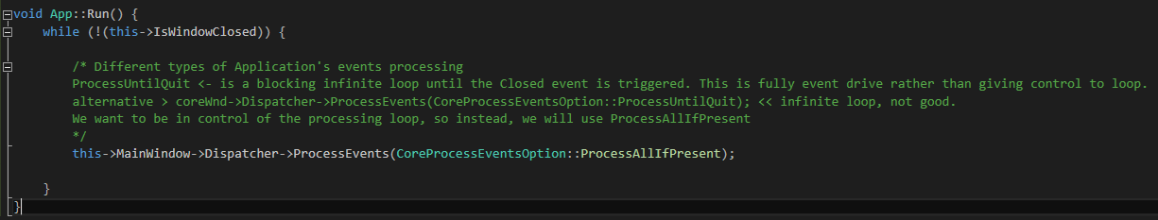
Application - App Setup
Fernando Geraci
7. Finally, we implement our app’s main Run method. This will go and listen for input until the main window has been closed.

Slide 11
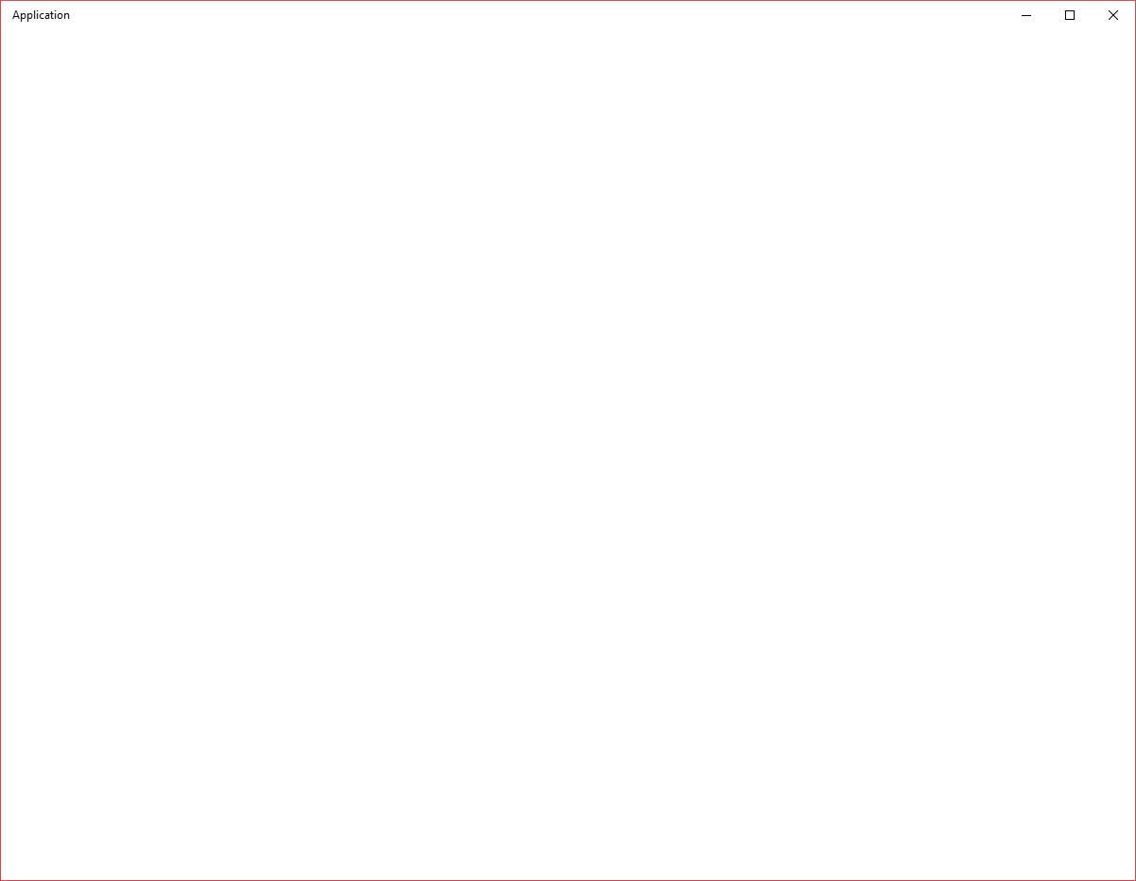
Application - Result
Fernando Geraci
At this point, you should see:
We are ready to start coding our application in it!
All the action will happen in the Run() method. Which is:
Run
while(!windowClosed) {
processInput;
if(timer_tick) {
MyApp.Update();
}
}
}

